Slide 1
British Airways
Data Science

Slide 2
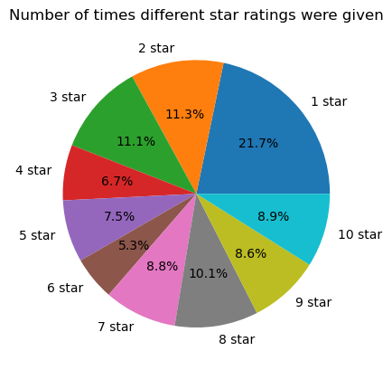


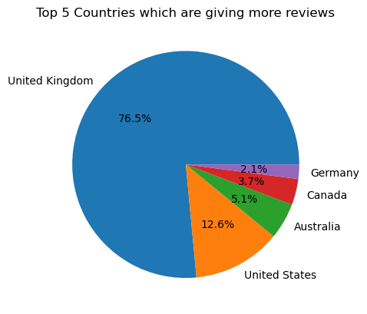
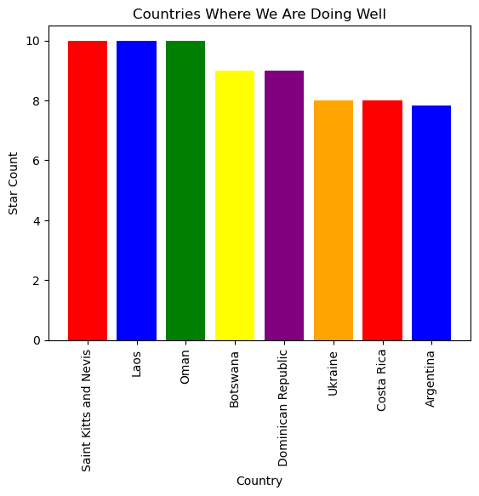
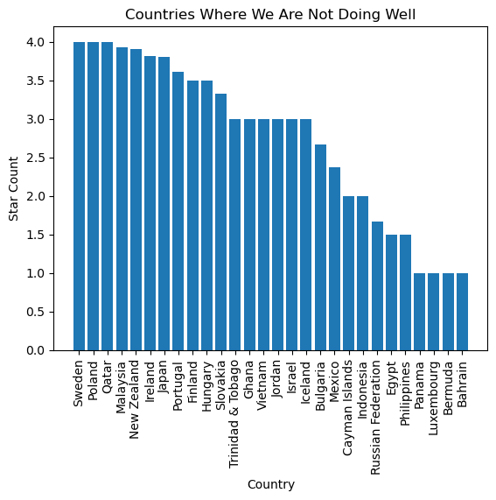
Visuals to Get Insights
What people are talking:
Sentiments
Overall Rating:
Positive
19%
Neutral
70.6%
Negative
10.4%

